Slide 1
Extra Class on ER diagram
Instructor: Kazi Amit Hasan

Slide 2
Topic
Weak Entity
Total and Partial Participations
Example solving

Slide 3
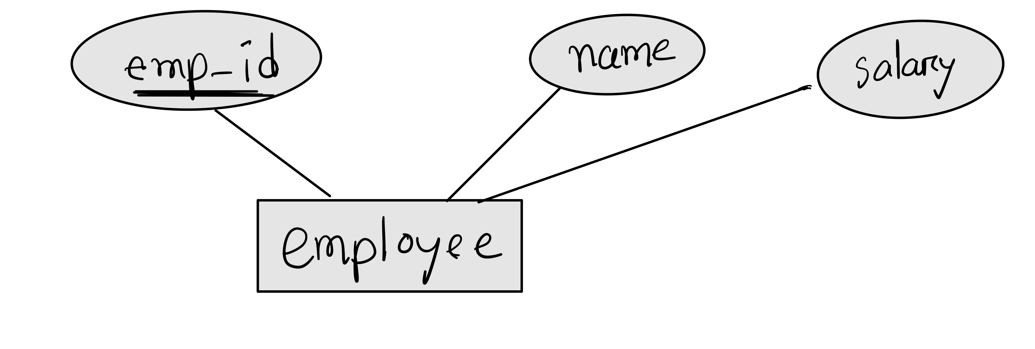
Strong and Weak Entity
Strong entity:
An entity set which has a key

Slide 4
Strong and Weak Entity
Weak entity:
An entity set which does not have a key attribute
It have a partial discriminator
They depend on strong entity

Slide 5
Amount
E_id
Name
Name
Age
Owner
entity
Identifying
relationship
Has
Employee
Dependent
Dependent
Weak entity
address
Dependent always participate totally. Kate and Sophia would only exist if Employee table has E1
E1 E2 E3
Alex Nick Marcos
Toronto Perth Ottawa
Kate Sophia Kate
25 6 25

Slide 6
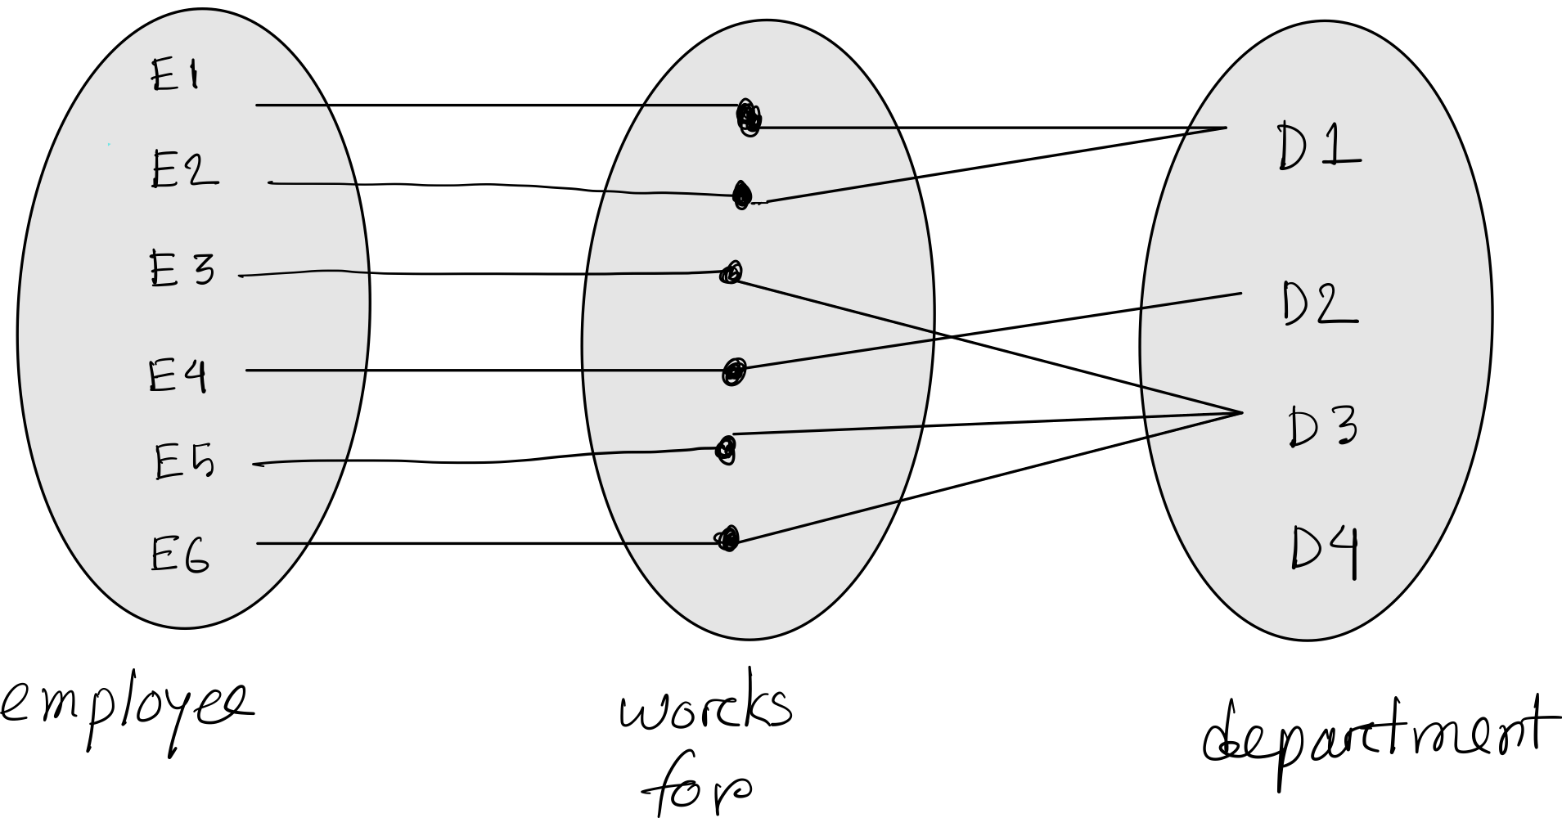
Participation
Every employee works for a department, and one department can have many employees. New departments need not to have any employee.

Slide 7
Min(emp) = 1
Min(dept) = 0
Max (emp) = 1
Max (dept) = 3
Degree: In every relationship, how many entity sets are participating >> 2
Participation: what is the minimum number of relationships an entity can participate. Also known as minimum cardinality.
Cardinality: what is the maximum number of relationship in which an entity can participate

Slide 8
Min(emp) = 1
Min(dept) = 0
Max (emp) = 1
Max (dept) = 3
If min (cardinality) = 1 >> total participation
If min (cardinality) =0 >> partial participation

Slide 9
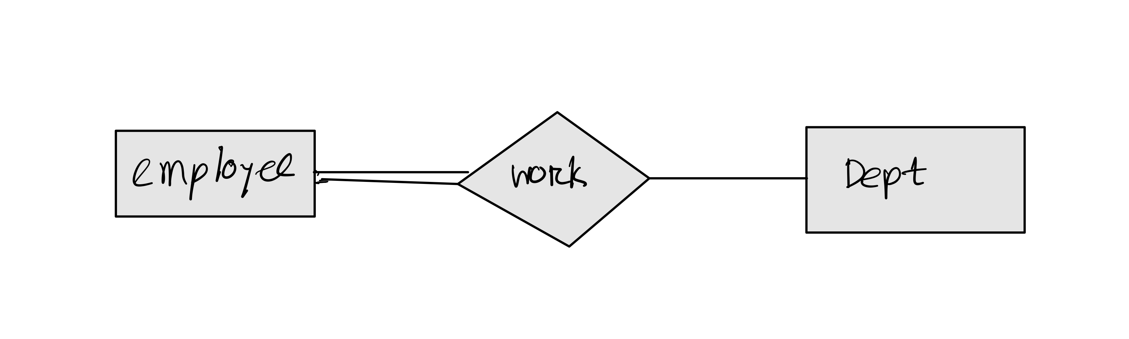
Min(emp) = 1
Min(dept) = 0
Max (emp) = 1
Max (dept) = 3

Slide 10
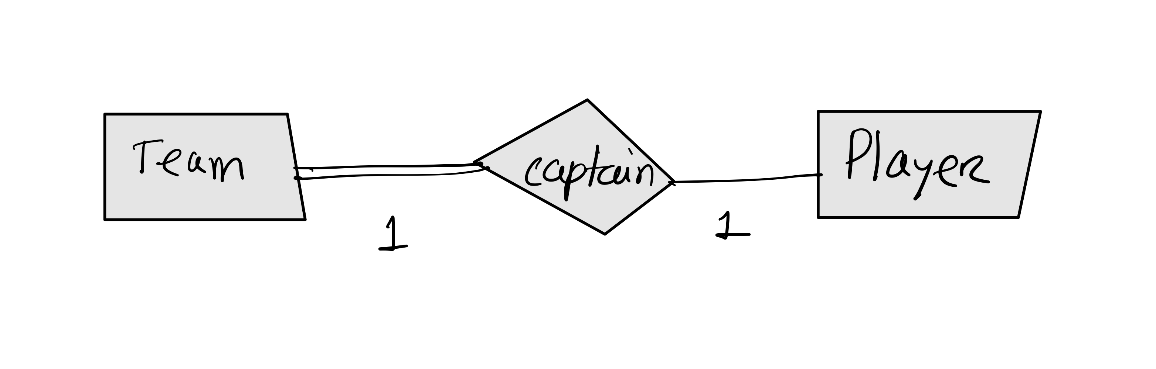
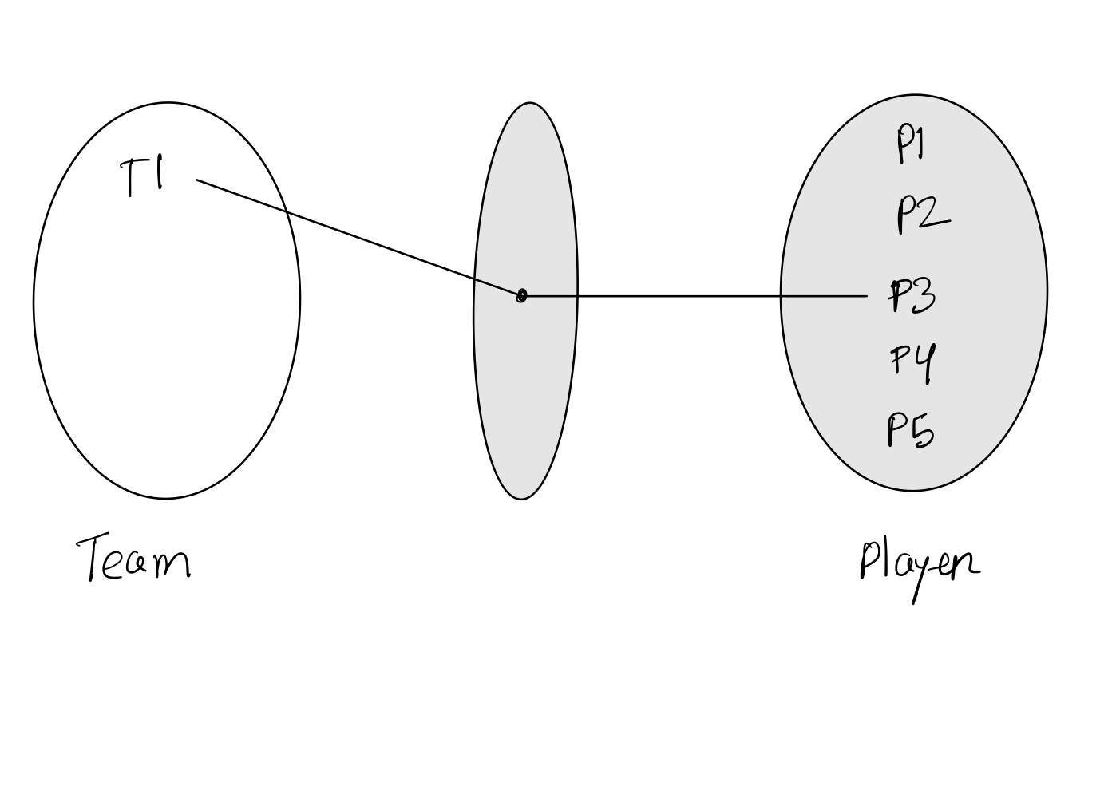
Min(team) = 1
Min(player) = 0
If min (cardinality) = 1 >> total participation
If min (cardinality) =0 >> partial participation

Slide 11
Steps to draw ER diagram
Read the question
Read the question (again)
Read the question(again)
Identify the entity sets
Identify the relevant attributes
Identify the primary keys (and any other keys)
Identify the relationships
Complete the diagram

Slide 12
Question
The Eldercare Retirement home wishes to store information about their residents including their names, ages, date of birth, OHIP numbers.
Many of the residents in Eldercare are married couples. We should note these relationships in the database.
Rooms are numbered 1-35. Each room is one of single, double or triple occupancy. Each room has a unique phone number. All residents are assigned to a room.
A number of people work at Eldercare. Nurses are identified by a unique ID and have a single rank (RN, RNA etc), a name and an address. Nurses also have a work schedule that indicates the date of their shift, the start time and the end time. A nurse would not be assigned two shifts on the same date.
Eldercare employs a number of doctors each with different types of specialties (a doctor may be more than one type of specialist). A doctor has an employee ID, a name and an address and one or more phone numbers where they can be reached.
Residents are treated by one or more Eldercare doctors but all residents have a single primary care doctor.
Eldercare has a staff of "helpers" and each has an employee ID, a name and an address. We'd also like to keep track of how long the helper has been working at Eldercare. Helpers are assigned to help specific patients and each resident is assigned exactly one helper.

Slide 13
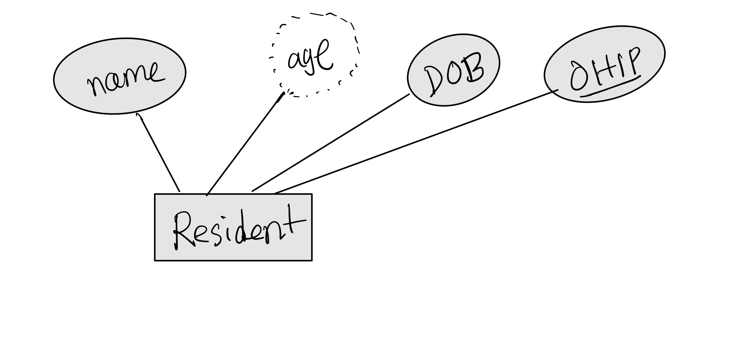
Question
The Eldercare Retirement home wishes to store information about their residents including their names, ages, date of birth, OHIP numbers.
Assuming ohip is unique

Slide 14
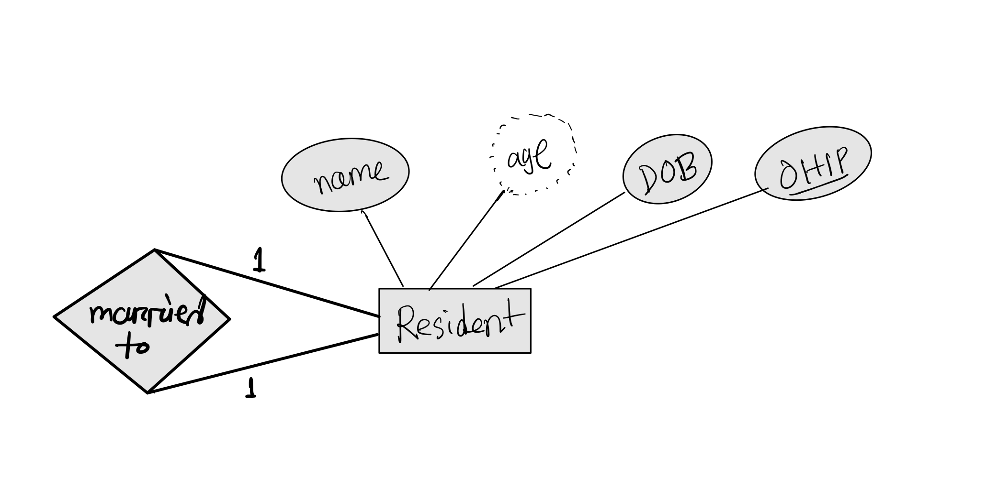
Question
Many of the residents in Eldercare are married couples. We should note these relationships in the database.

Slide 15
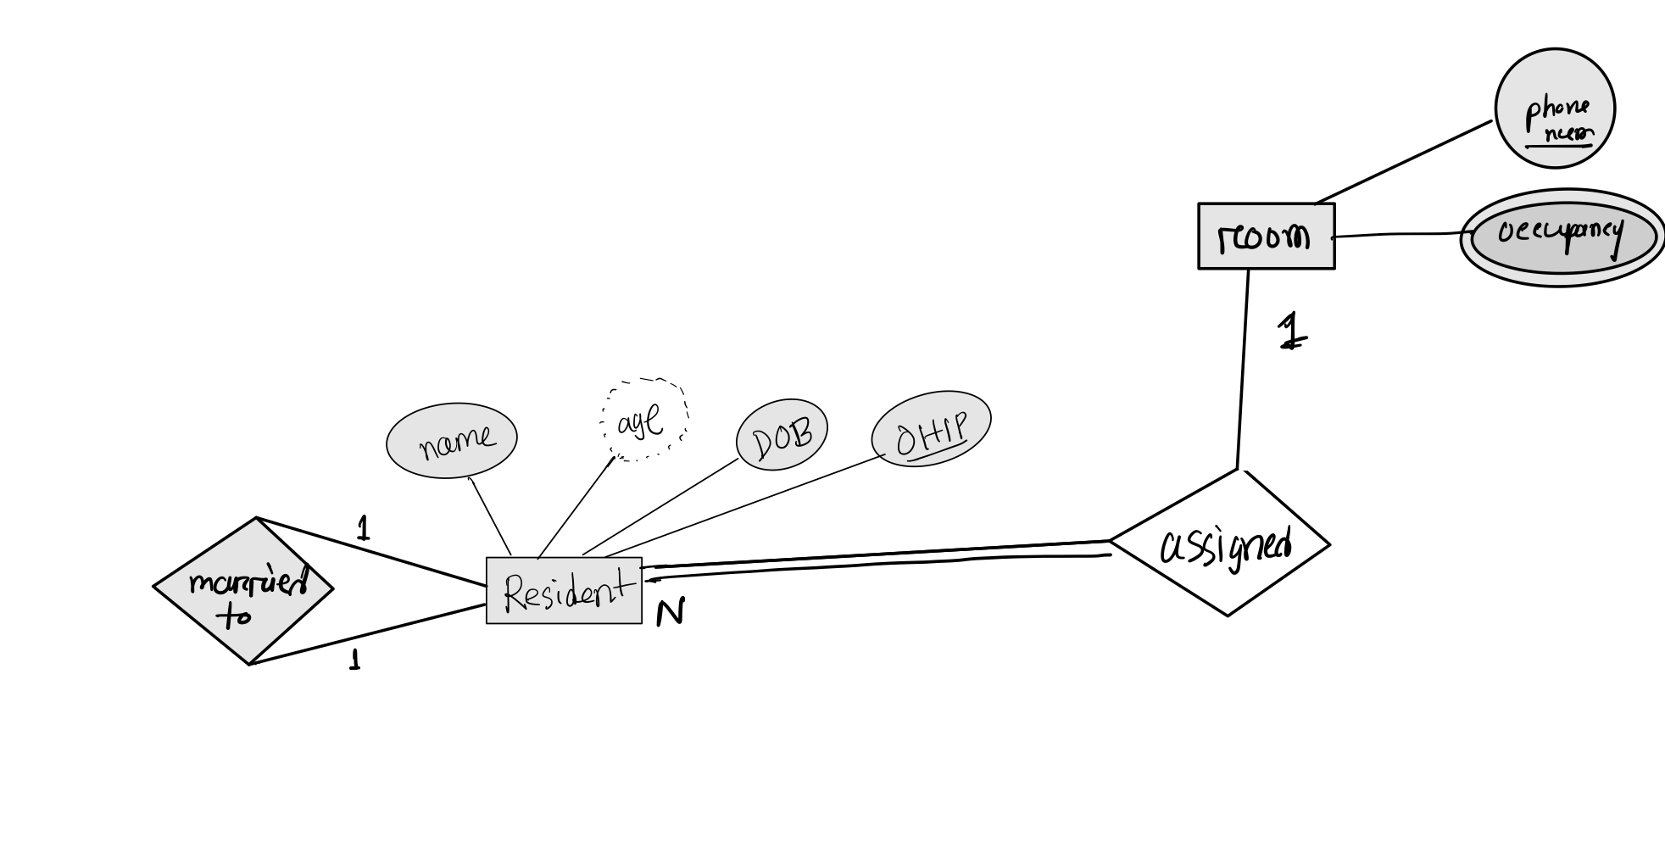
Question
Rooms are numbered 1-35. Each room is one of single, double or triple occupancy. Each room has a unique phone number. All residents are assigned to a room.

Slide 16
Question
A number of people work at Eldercare. Nurses are identified by a unique ID and have a single rank (RN, RNA etc), a name and an address. Nurses also have a work schedule that indicates the date of their shift, the start time and the end time. A nurse would not be assigned two shifts on the same date.
Can this entity be uniquely identified without another entity?
Does it depend on an owner to exist?

Slide 17
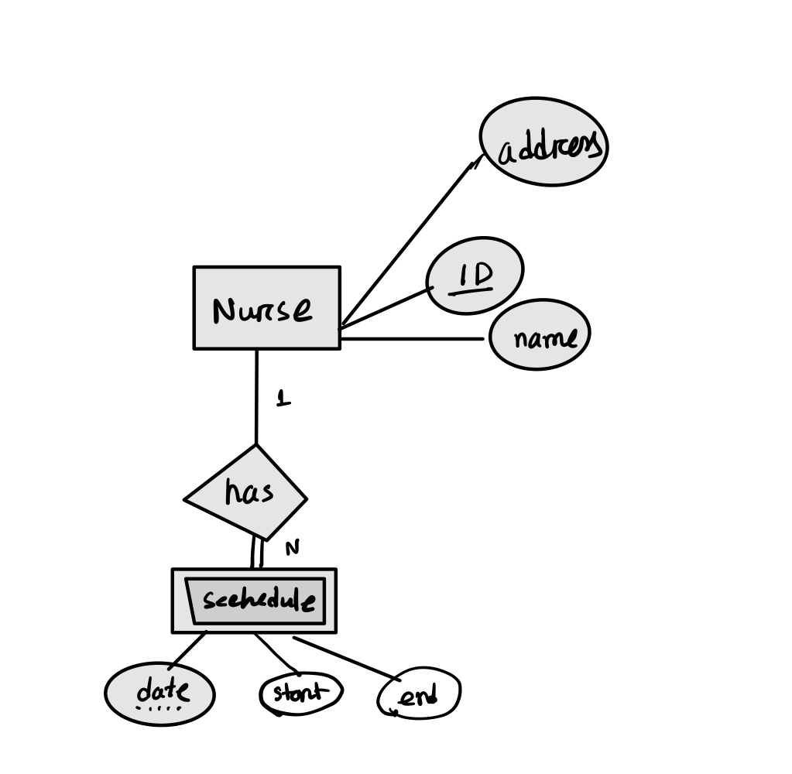
Question
A number of people work at Eldercare. Nurses are identified by a unique ID and have a single rank (RN, RNA etc), a name and an address. Nurses also have a work schedule that indicates the date of their shift, the start time and the end time. A nurse would not be assigned two shifts on the same date.

Slide 18
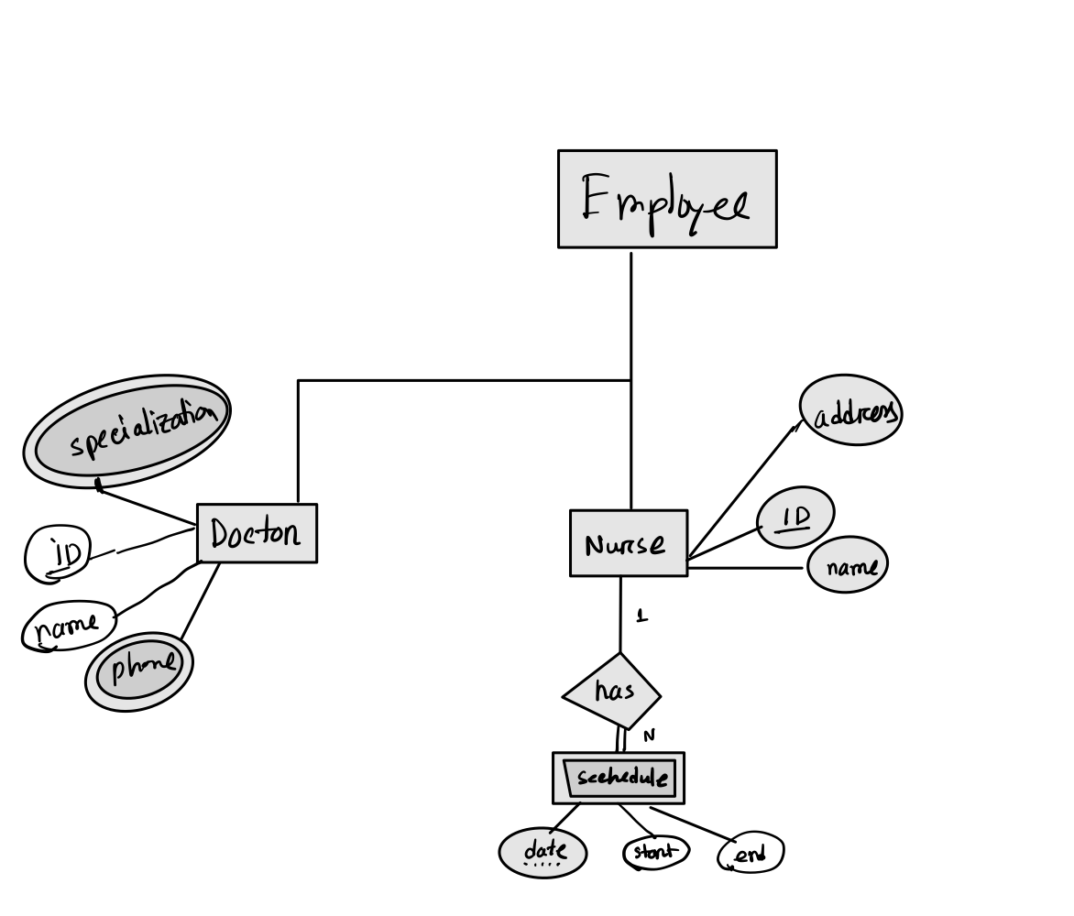
Question
Eldercare employs a number of doctors each with different types of specialties (a doctor may be more than one type of specialist). A doctor has an employee ID, a name and an address and one or more phone numbers where they can be reached.

Slide 19
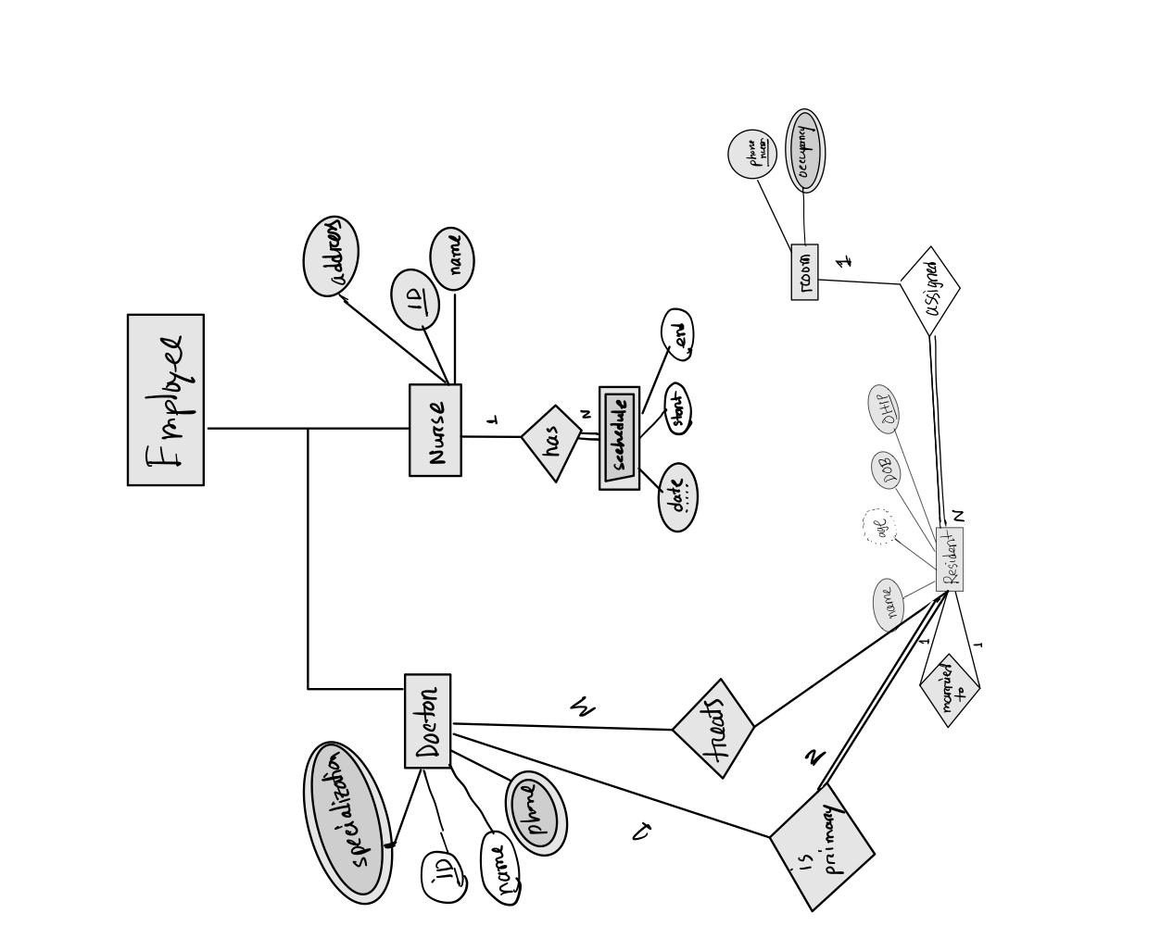
Question
Residents are treated by one or more Eldercare doctors but all residents have a single primary care doctor.

Slide 20
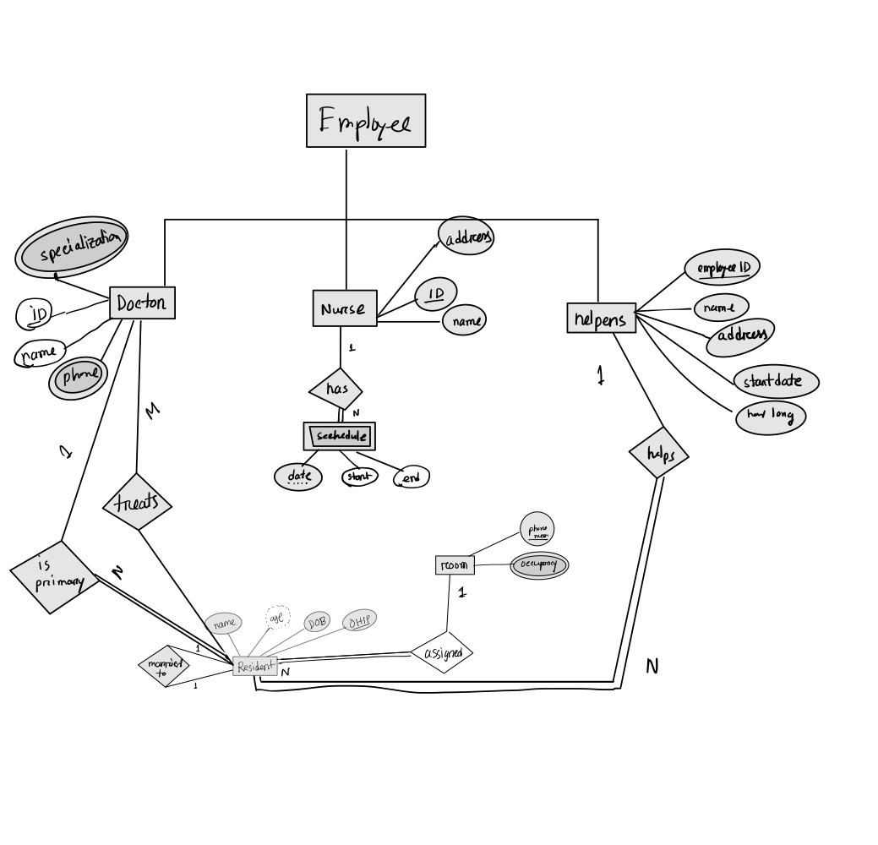
Question
Eldercare has a staff of "helpers" and each has an employee ID, a name and an address. We'd also like to keep track of how long the helper has been working at Eldercare. Helpers are assigned to help specific patients and each resident is assigned exactly one helper.
Assuming
- we have startdate
- ohip is unique

Slide 21
Can we further simplify this?
Assuming
- we have startdate
- ohip is unique

Slide 22
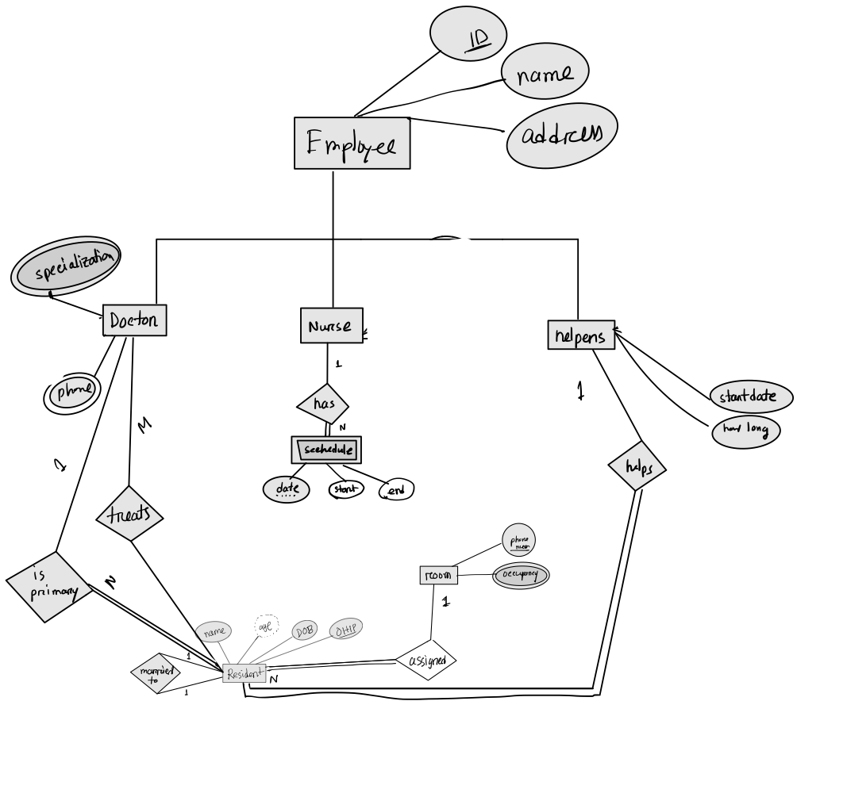
Assuming
- we have startdate
- ohip is unique

